Slide 1



Cepheid
Detecting acute HIV infection in vulnerable populations: FRESH study
Thumbi Ndung’u, BVM, PhD
Investigator, Africa Health Research Institute (AHRI)
Professor and Director, HIV Pathogenesis Programme (HPP), Doris Duke Medical Research Institute
Nelson R. Mandela School of Medicine
University of KwaZulu-Natal
Cepheid Integrated Symposium, IAS 2018 Conference, Amsterdam, Netherlands
23 July June 2018
Gwynn Stevens
Director HIV and Virology HBDC (SA)
Jacquie Ross
Corporate VP
John L. Bishop
Chairman & CEO
Philippe Jacon
President HBDC

Slide 2
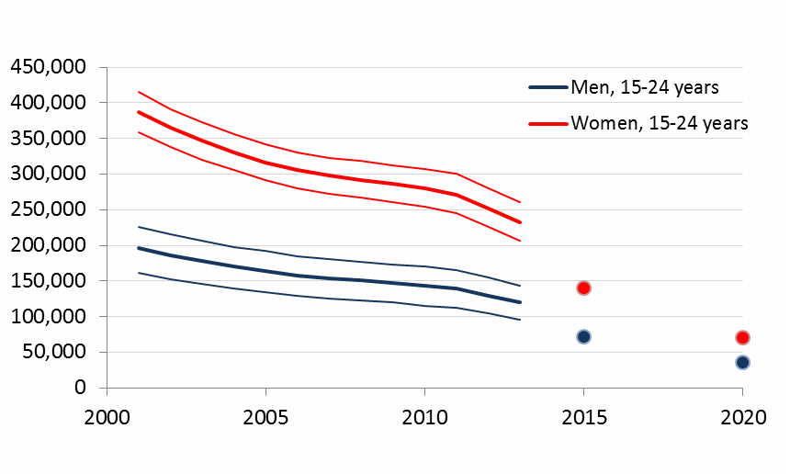

Eastern and southern Africa: high new HIV infections among young women aged 15-24 years
HIV incidence remains unacceptably high among young women in sub-Saharan Africa
There is a need to better understand the reasons for high incidence, and evaluate interventions that can reduce infections
Monitoring of those infected and on ART is essential for HIV control

Slide 3
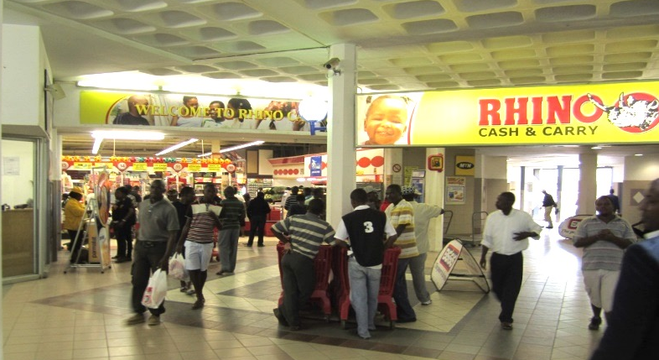

FRESH – Acute HIV Infection Study
Females Rising through Education, Support and Health
Dual Goals: 1. Detection and treatment of acute HIV infection
2. HIV prevention, poverty reduction
Method: 1. Enroll young HIV-uninfected females at high-risk of infection
2. Frequent surveillance - finger prick HIV RNA test 2x/week
3. Integrate science with a socio-economic intervention
(boost enrolment/adherence/retention)

Slide 4
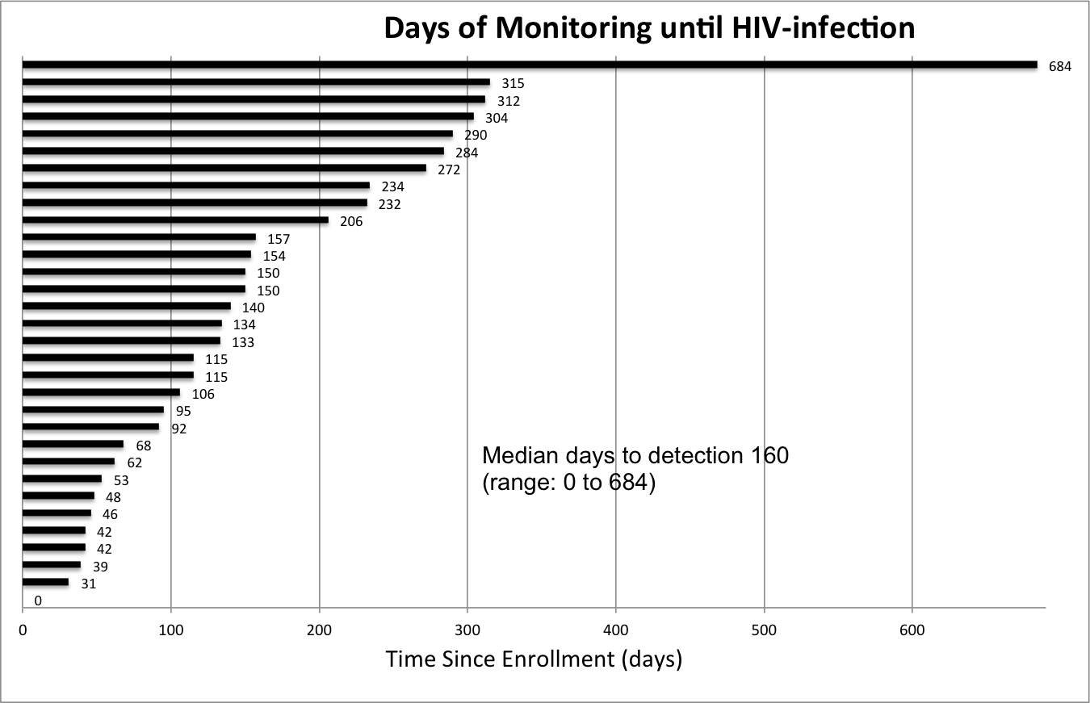
71 acute infections detected
As of April 2018:
> 1,600 enrollees
Incidence 8.3 (95% CI=5.8-12.0) per 100 p/y
14 untreated, 57 treated early
> 70% Fiebig I
Median 4 days since last negative HIV RNA
ART started within median 1 day

Slide 5
Raltegravir intensification reduces time to full suppression

Slide 6
Participants treated in Fiebig stage I do not seroconvert*
*WB- Biorad GS kit

Slide 7
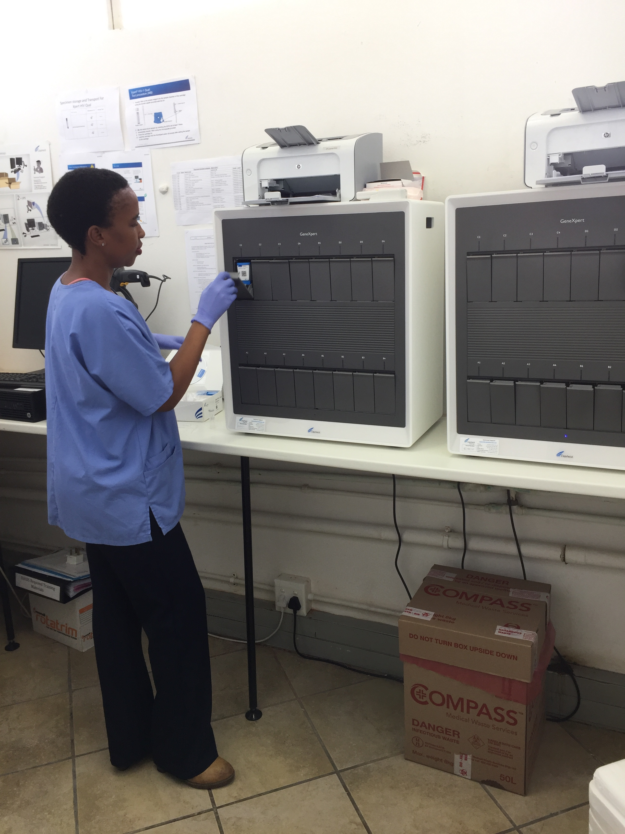
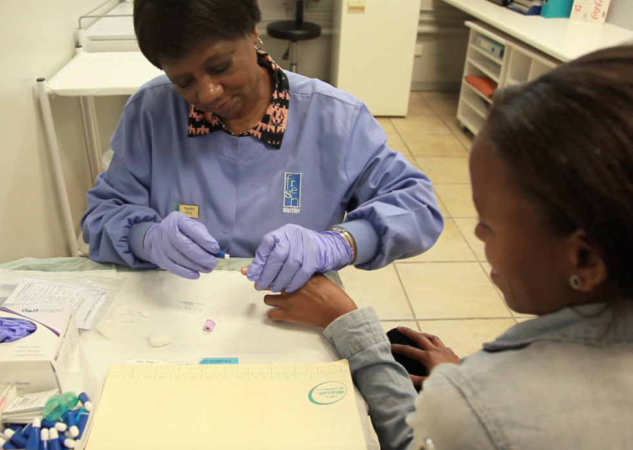
Frequent VL monitoring (RNA PCR)
NuclisensEasyQ®️
Pre-infection surveillance
Post-infection monitoring
Added point-of-care VL
Oct 2016, after 49 acutes identified
Xpert HIV-1 qual®️ cartridges
Post-infection monitoring
Results in 1 day vs. 90 min.
(serum / lab) (whole blood)

Slide 8
We compared with HIV-1 RNA PCR
Ease of use for inexperienced clinic staff
Concordance with RNA PCR results
Sensitivity (RNA detects 20-100 copies)
Feasibility for very early HIV detection (for immediate ART initiation)
Feasible for detection of low level viral blips (monitor early treatment default)
Xpert HIV-1 qual®️
Detects total nucleic acid; both RNA and proviral DNA in one cartridge

Slide 9
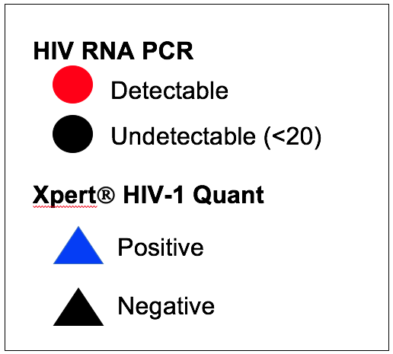
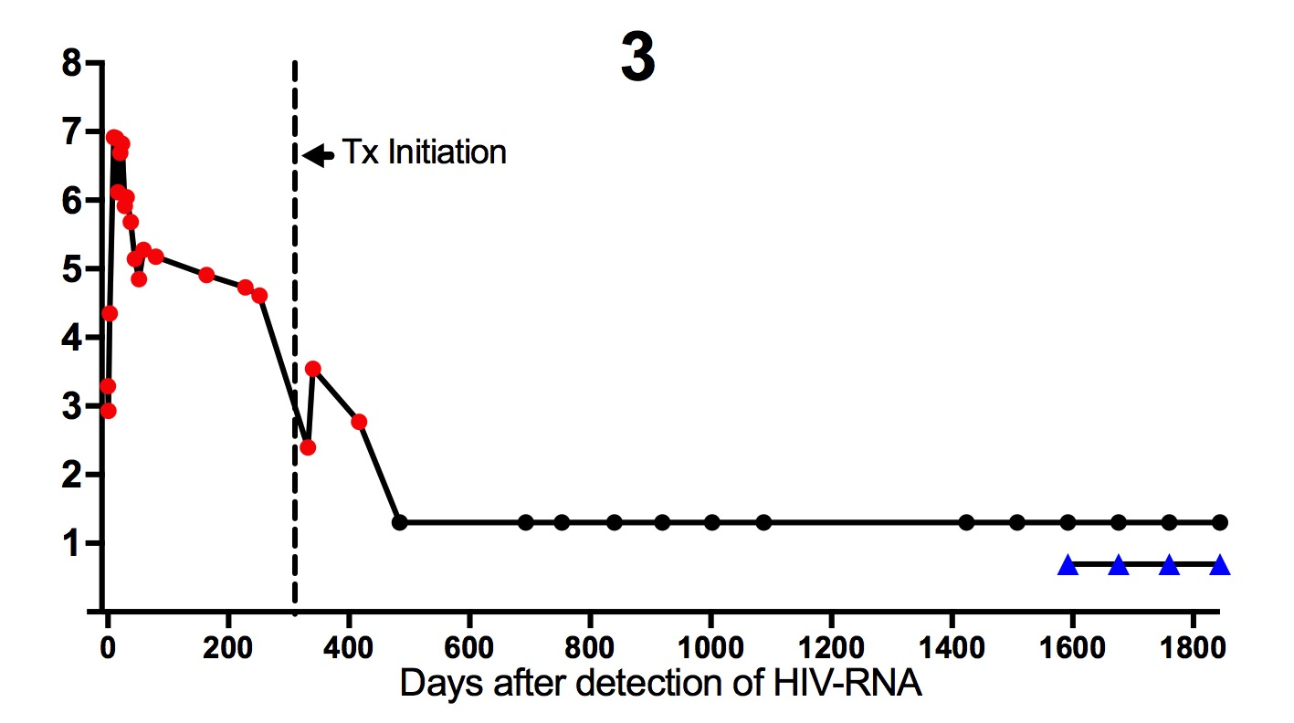
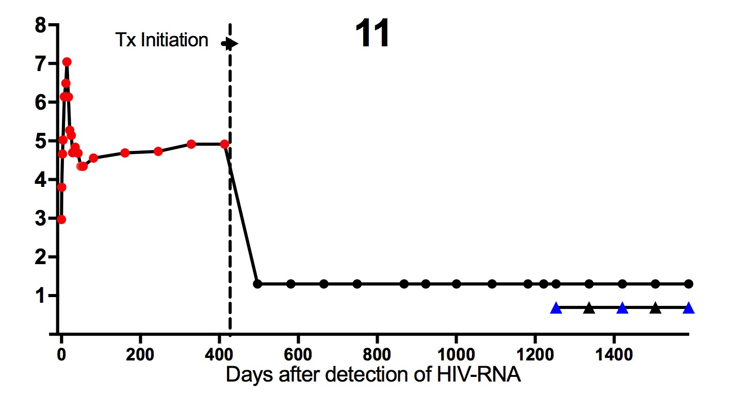
Treatment initiated during chronic HIV infection (n=11)
10 / 11 (91%) RNA PCR Undetectable + GeneXpert Detected
GeneXpert detectable throughout despite undetectable Roche RNA
Undetectable viremia but transient or intermittent GeneXpert detectable

Slide 10
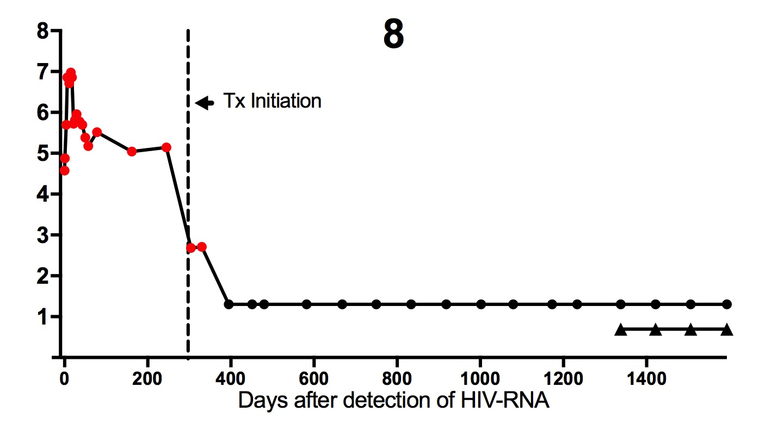
Untreated During Acute Infection (n=11)
1 / 11 (9%) RNA PCR Undetectable + GeneXpert Not Detected

Slide 11
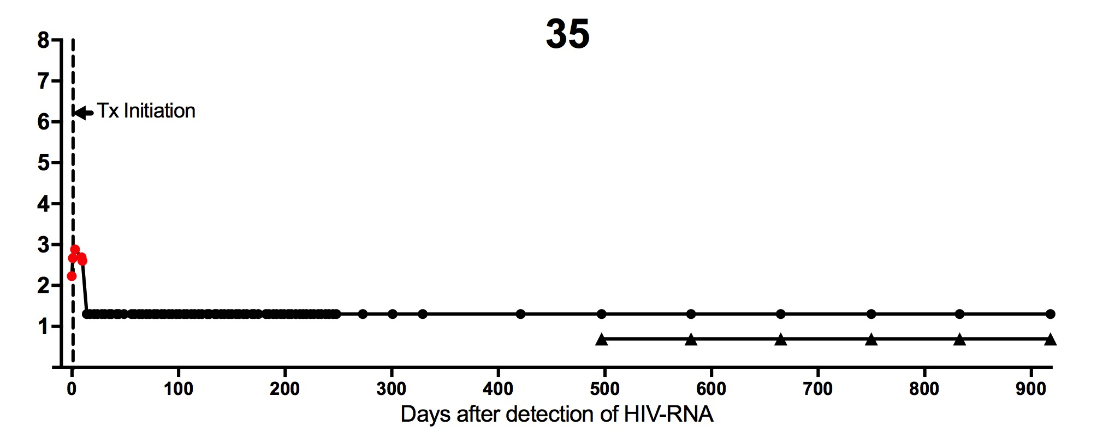
Early Treatment during Acute Infection (n=55)
29 / 55 (53%) RNA PCR Undetectable + GeneXpert Not Detected
26 / 29 (90%) were started on treatment in Fiebig stage I

Slide 12
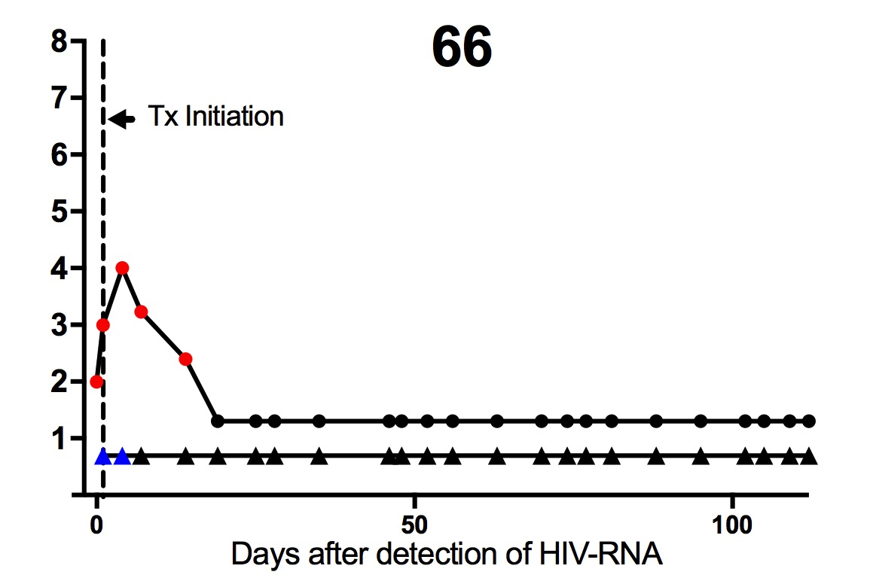
Treatment initiated during acute HIV infection (n=55)
29 / 55 (53%) RNA PCR Undetectable + GeneXpert Not Detected

Slide 13
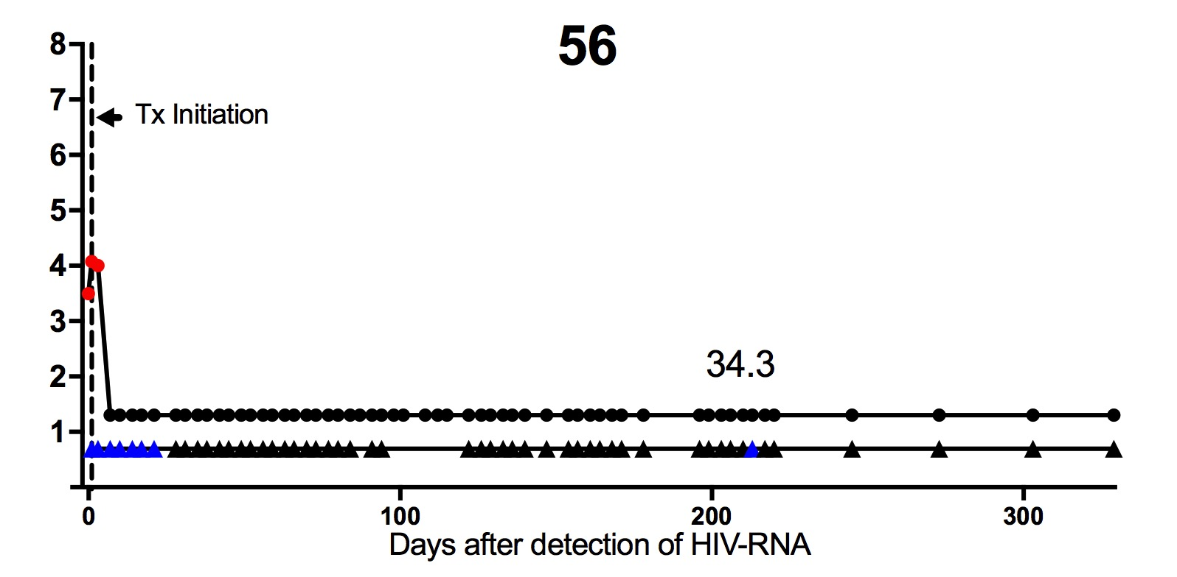
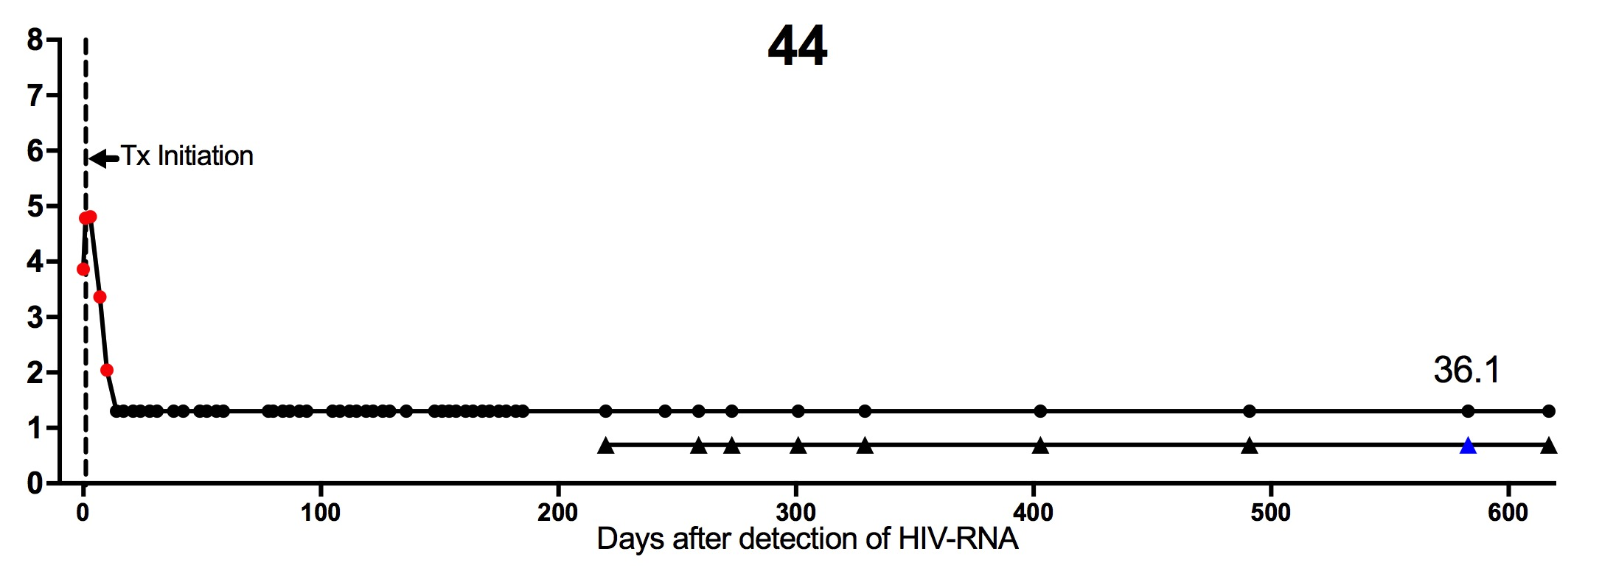
Early Treatment during Acute Infection (n=55)
9 / 55 (16%) RNA PCR Undetectable + GeneXpert Detected x1

Slide 14
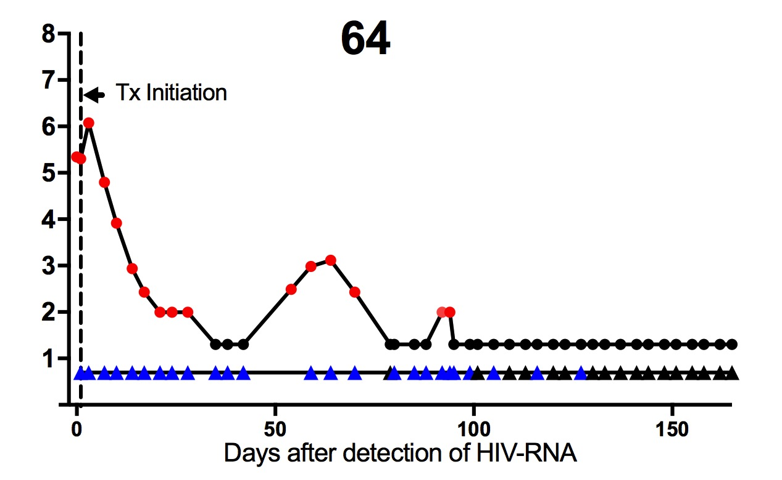
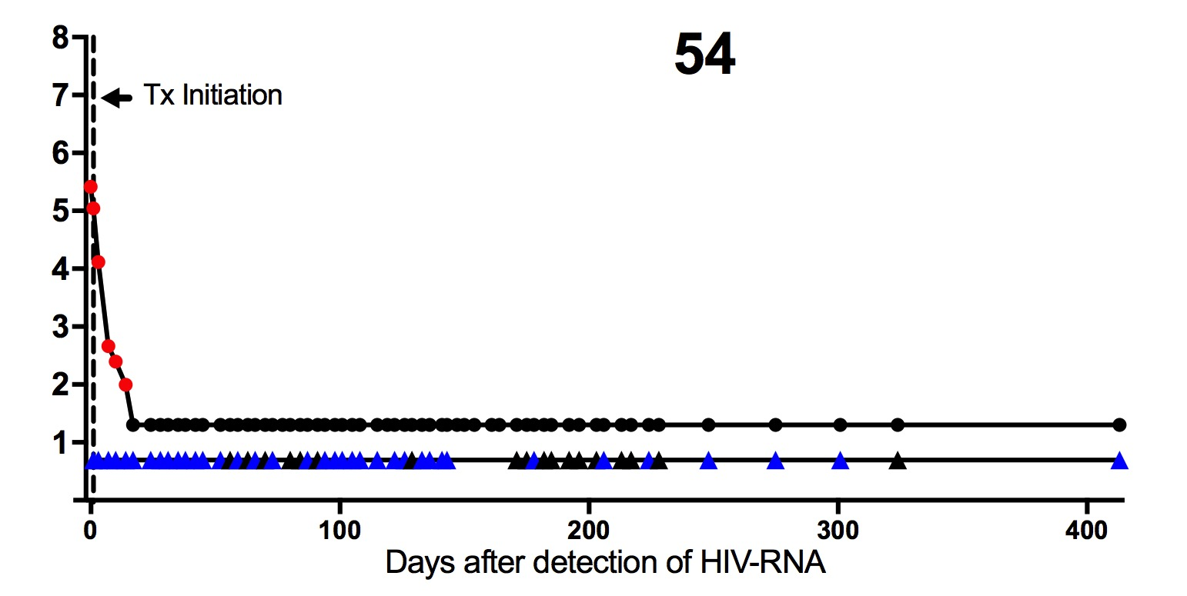
Transient and intermittent positivity on GeneXpert is common
14 / 55 (25%) RNA PCR undetectable + GeneXpert intermittently detected
RNA PCR Undetectable + GeneXpert detected & Not detected
RNA PCR Undetectable + GeneXpert intermittent negative

Slide 15
Some GeneXpert + individuals report non-adherence to ART
9 / 55 (16%) RNA PCR Undetectable + GeneXpert Detected x1
Acute | # Days Post Detection | RNA PCR Viral Load | GeneXpert Result | Non Adherence (Self Report + Pill Count)
18 | 815 | - | + | Yes
25 | 753 | - | + | No
42 | 413 | - | + | No
44 | 583 | - | + | Yes
46 | 161 | - | + | No
51 | 60 | - | + | Unknown
56 | 213 | - | + | Yes
59 | 77 | - | + | Yes
71 | 45 | - | + | Yes

Slide 16
In the FRESH Cohort
  For those who start treatment during chronic infection
    45% remained Xpert positive after VL suppression
    45% had a changing Xpert result (positive → negative) after VL suppression
    HIV Xpert result may become negative after prolonged viral suppression
  For those immediately treated during AHI
    53% had a positive Xpert result during initial viremia, and reverted to negative after VL suppression
    The majority (90%) who revert to negative Xpert result, started ART during Fiebig stage I
  Detection of non-adherence during VL suppression
    GeneXpert detected viral “blips” during HIV RNA suppression (<20 copies), that correlated to confirmed non-adherence 56% of the time

Slide 17
General findings
Ease of use: VL monitoring by GeneXpert was easy to perform by non-laboratory clinic staff.
Concordance: There was high concordance with HIV RNA quantitative PCR during viremia
Sensitivity: At least as sensitive as HIV RNA quantitative PCR. Able to detect “blips” due to non-adherence, during RNA suppression
Early detection: Able to detect low level viremia, thus may be ideal for AHI detection (provided cost-effective vs. lab based assay)

Slide 18
Cepheid HIV GeneXpert – Research Applications
  Detection of acute HIV infection (AHI)
  Initiation of Immediate ART:
    90 min processing time (vs. 1 day) would enable treatment initiation same day as AHI detection. Feasibility depends on budget/cartridge pricing.
  Detection of viremia within clinical trials
    Vaccine trials (prevention) – VL breakthrough monitoring
    Clinical trials – VL monitoring during analytical treatment interruption (ATI) for (novel treatment and cure studies)
  Limitations
    Variable positivity during viral suppression
    Negative results after early treatment initiation
    Cost compared to lab-based HIV RNA PCR

Slide 19
Cepheid HIV GeneXpert – Research Applications
  Detection of acute HIV infection (AHI)
  Initiation of Immediate ART:
    90 min processing time (vs. 1 day) would enable treatment initiation same day as AHI detection. Feasibility depends on budget/cartridge pricing.
  Detection of viremia within clinical trials
    Vaccine trials (prevention) – VL breakthrough monitoring
    Clinical trials – VL monitoring during analytical treatment interruption (ATI) for (novel treatment and cure studies)
  Limitations
    Variable positivity during viral suppression
    Negative results after early treatment initiation
    Cost compared to lab-based HIV RNA PCR

Slide 20
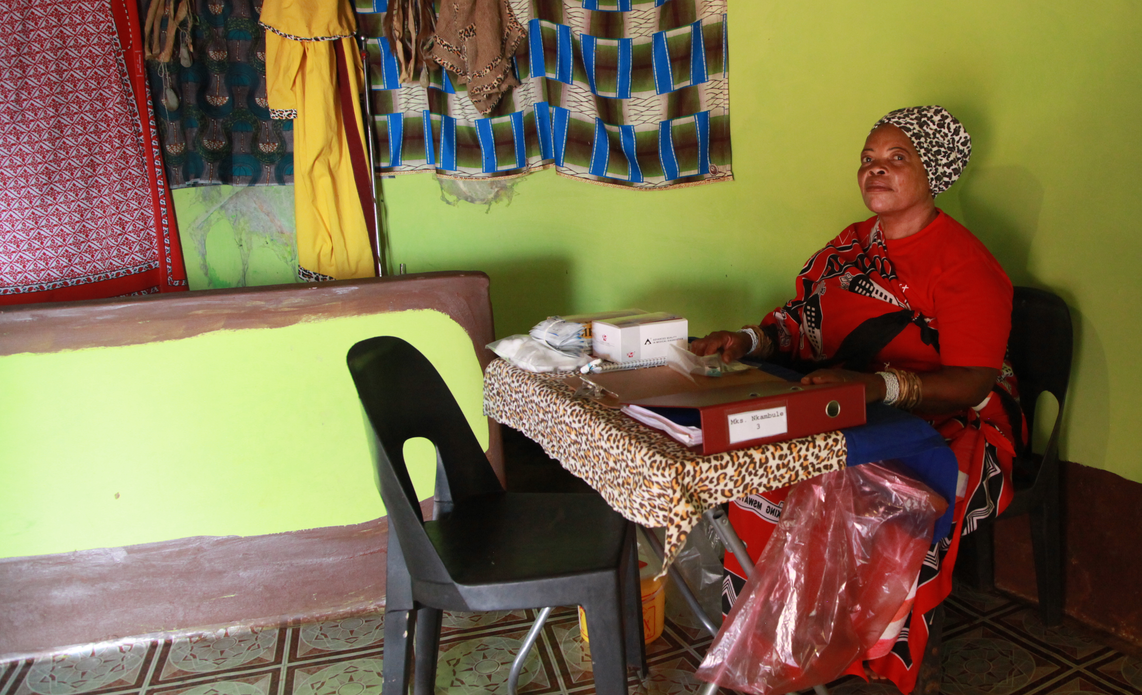
Completed pilot study: Community-based HIV testing and linkage to care by African Traditional Health Practitioners (THPs)

Slide 21

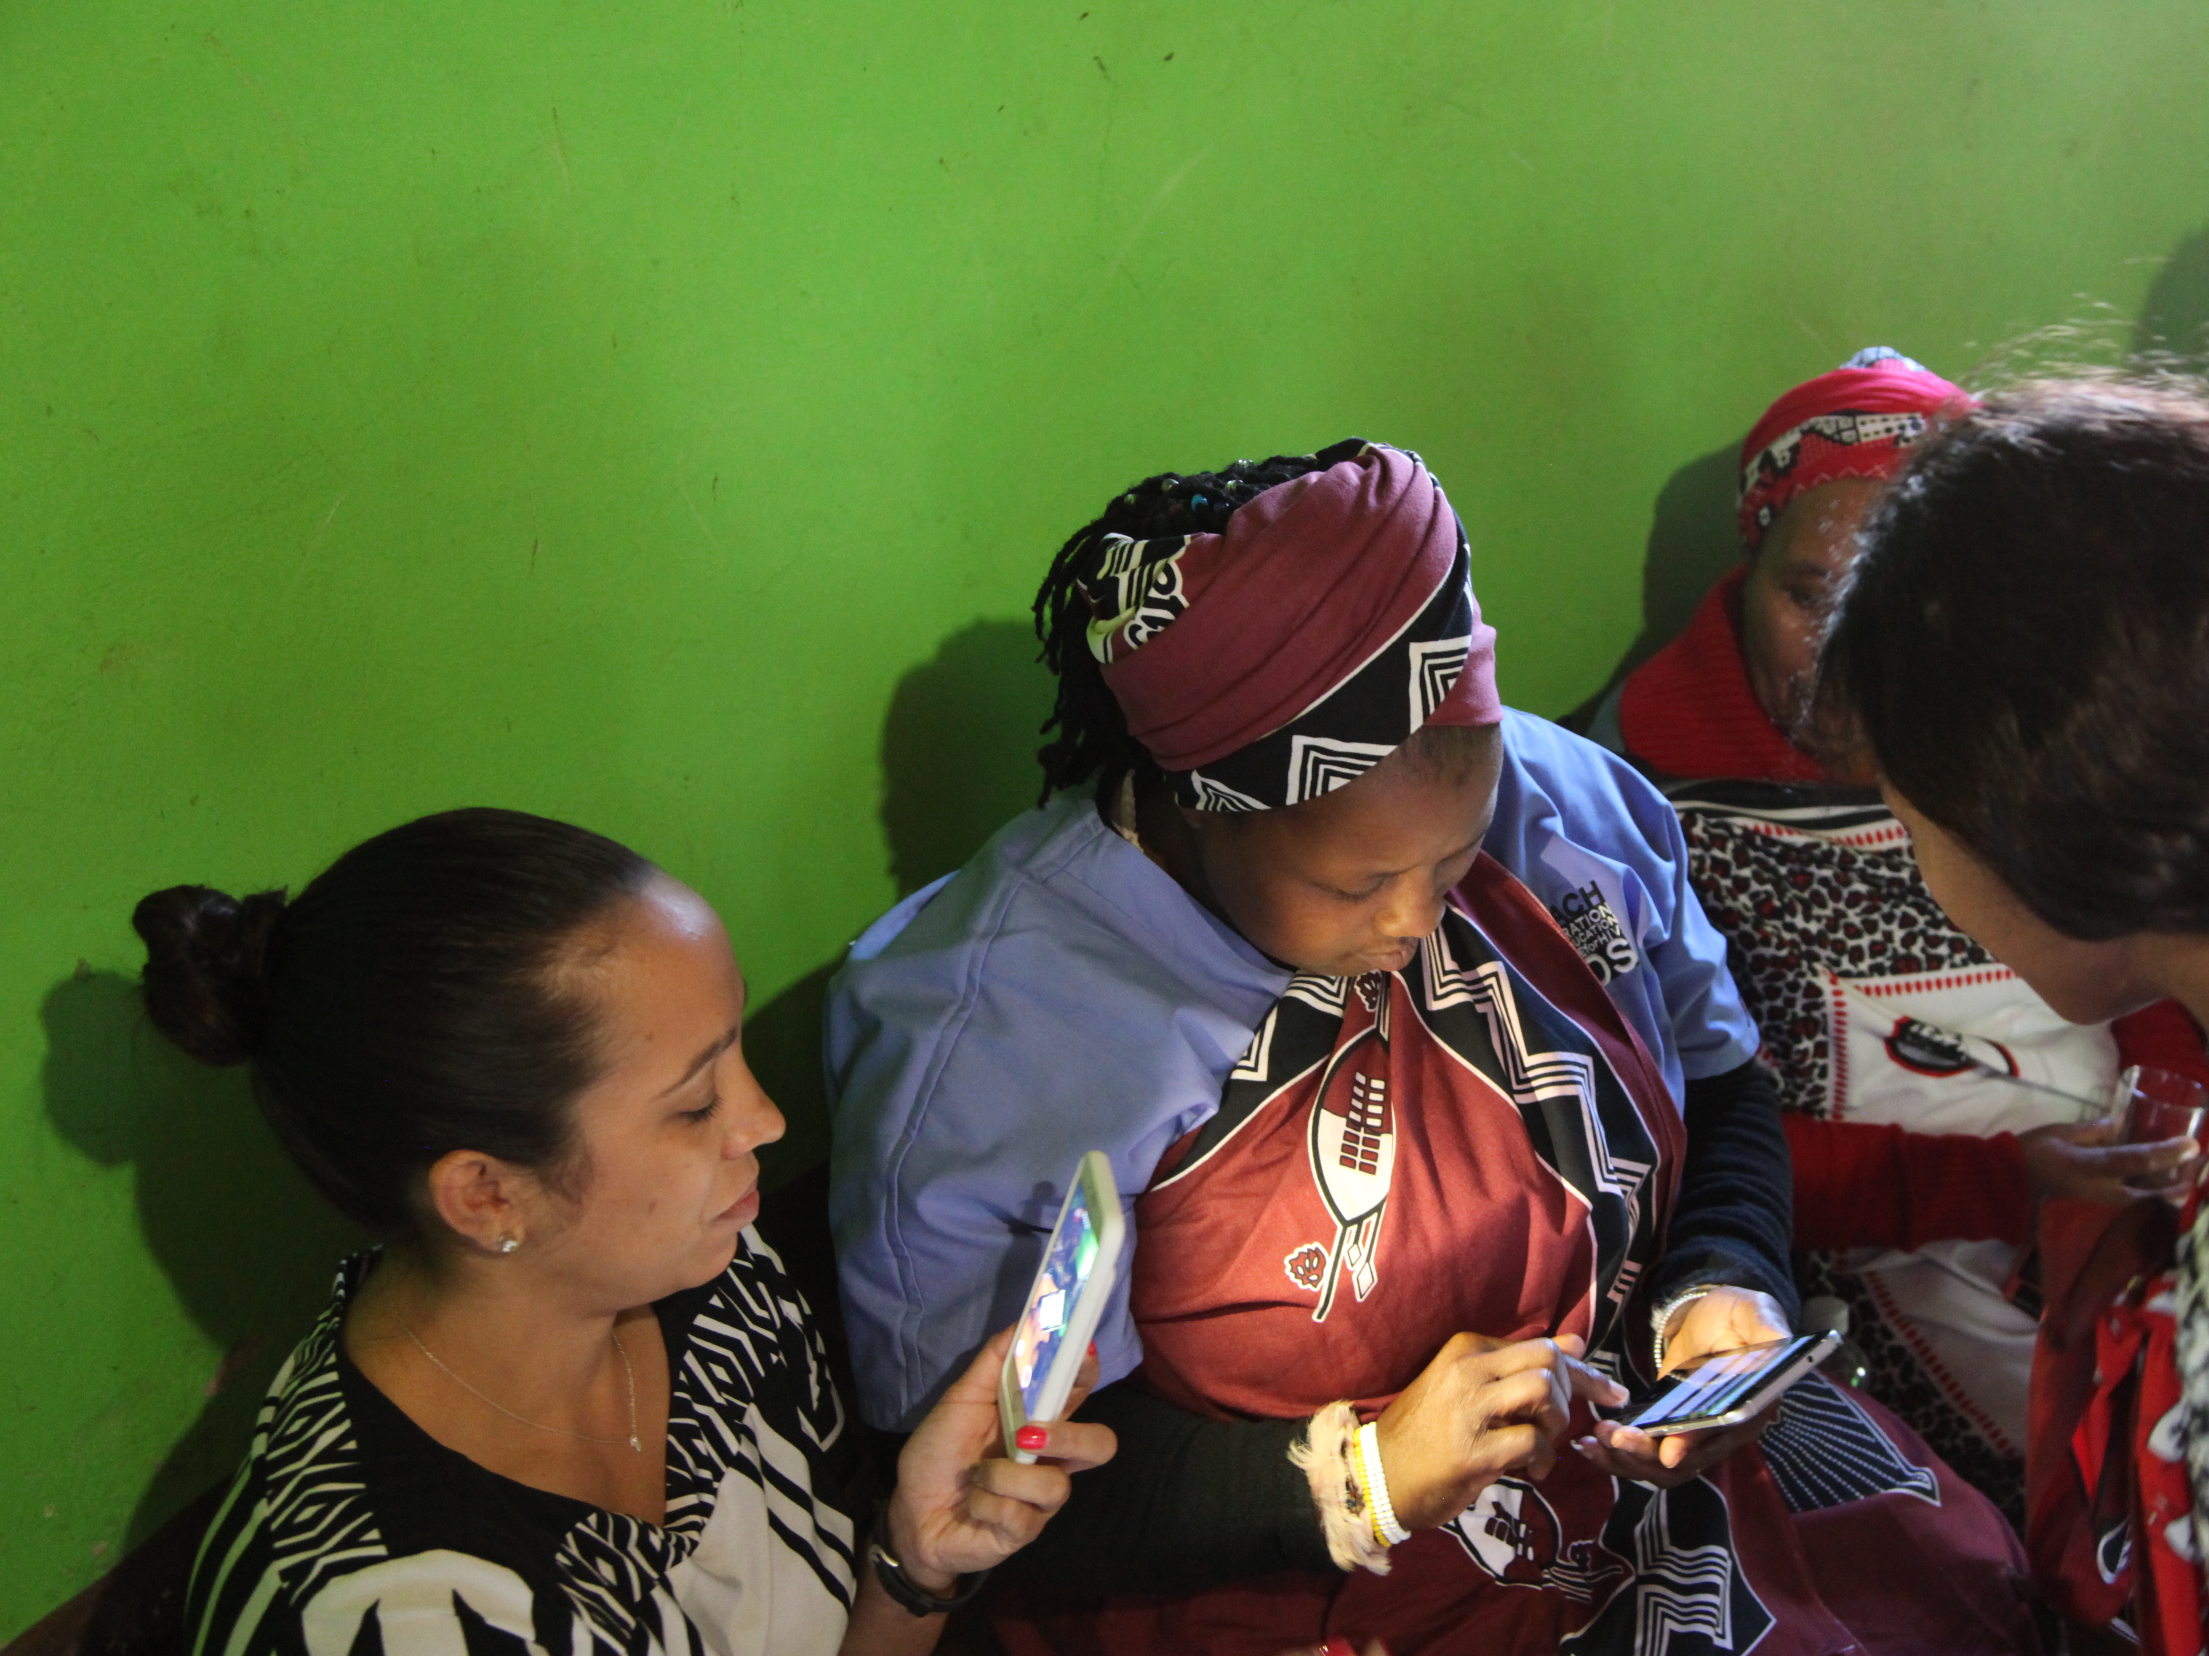
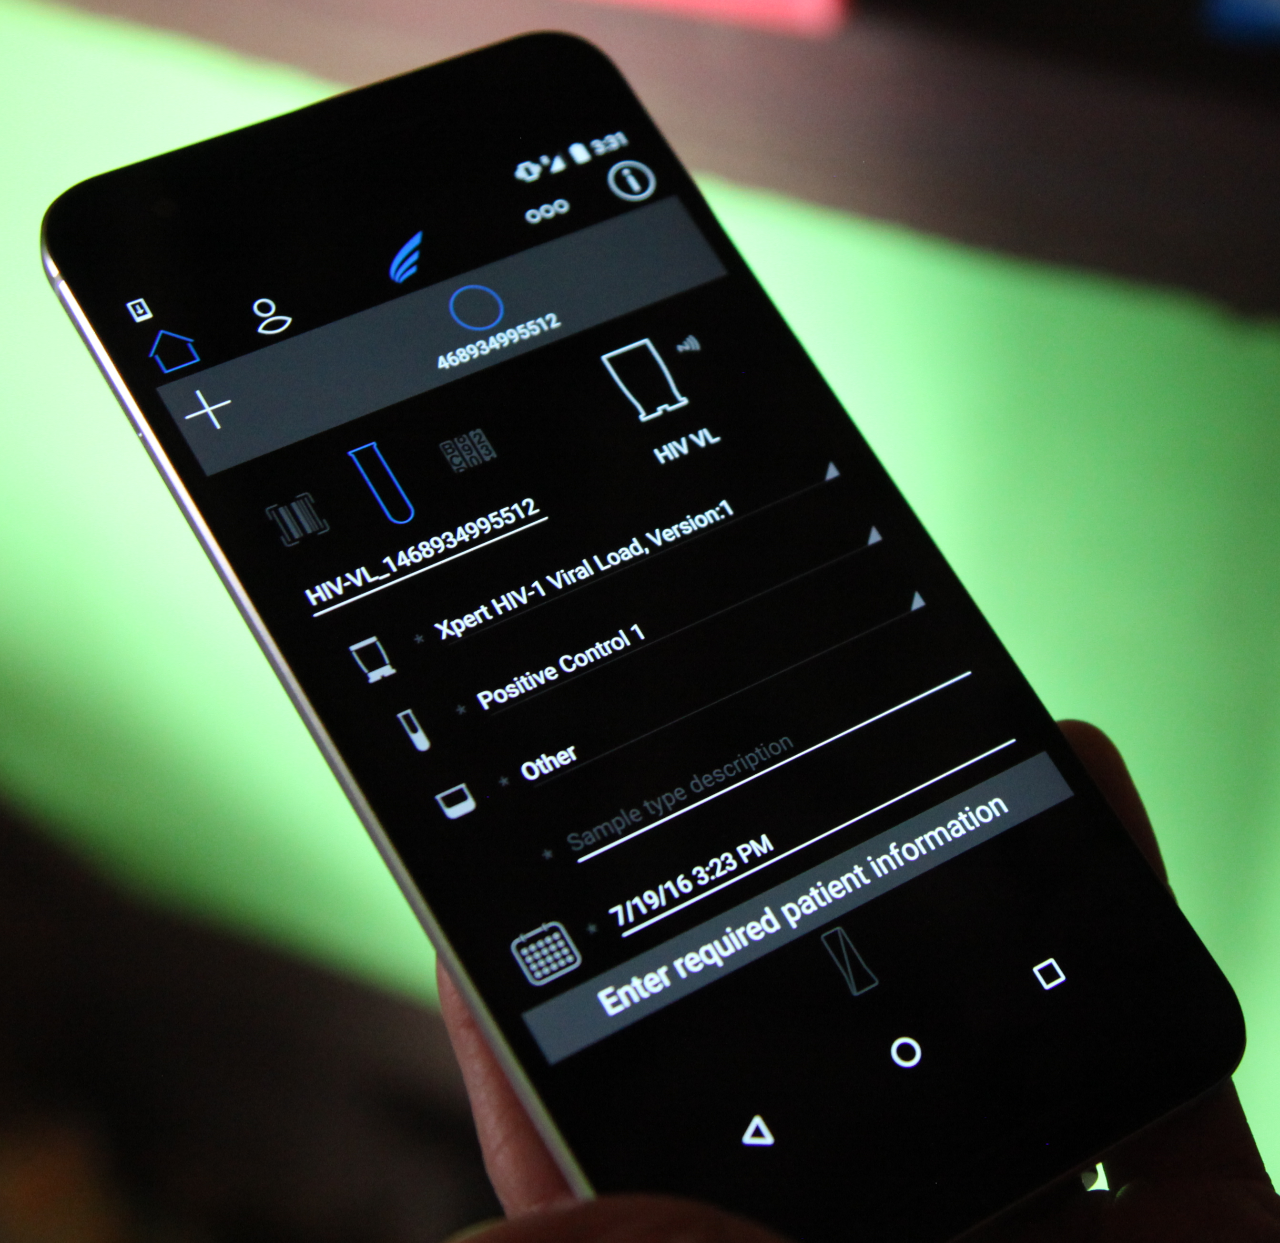

Point of cate HIV RNA testing such as the Xpert could be a powerful tool in the fight against HIV in the informal healthcare setting

Slide 22








Acknowledgements
HPP, FRESH, AHRI and UKZN
Krista Dong
Amber Moodley
Daniel Muema
Nasreen Ismael
FRESH study participants
FRESH study team
Harvard/MGH
Bruce Walker
Douglas Kwon
Musie Ghebremichael
Funding
Bill and Melinda Gates Foundation
IAVI
NIH
South African DST/NRF
HHMI
Gilead Sciences, Inc.
Cepheid

